Slide 1

Module 2.3 The World Wide Web
www
www
www

Slide 2
Contents
Introduction
Web pages and websites
Web addresses
Types of websites
Activity 1
Browsing and searching
What is a web browser?
What is a search engine?
Successful searching
Activity 2
Test and improve
Written module activity

Slide 3
Introduction
Web pages and websites
WWW
Vast collection of hyperlinked, interactive documents called web pages
Website
Group of related web pages stored at the same web address
Websites can be created by anyone (but cost money to maintain and support) – so usually belong to companies, organisations, special interest groups

Slide 4
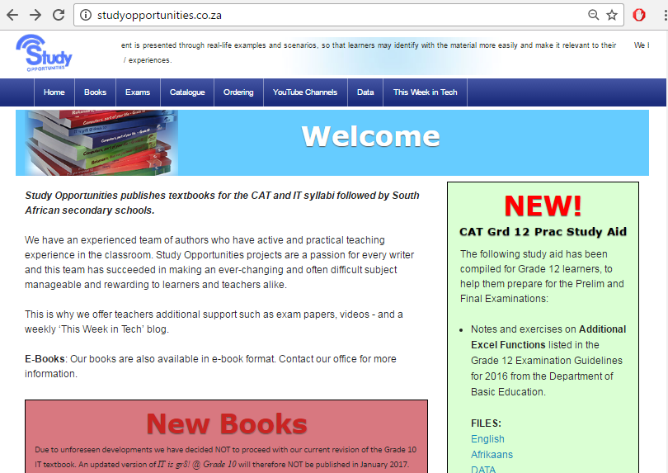
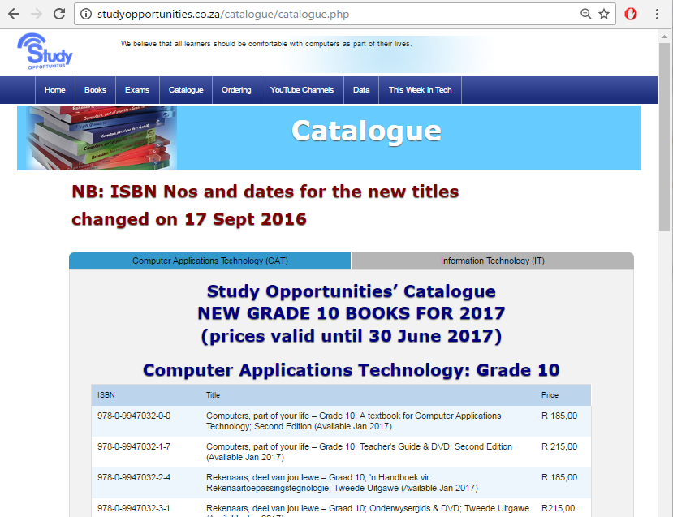
Introduction
Web pages and websites
Structure of a website
Home page – ‘landing page’
Web page – text, graphics, audio, video, hyperlinks

Slide 5
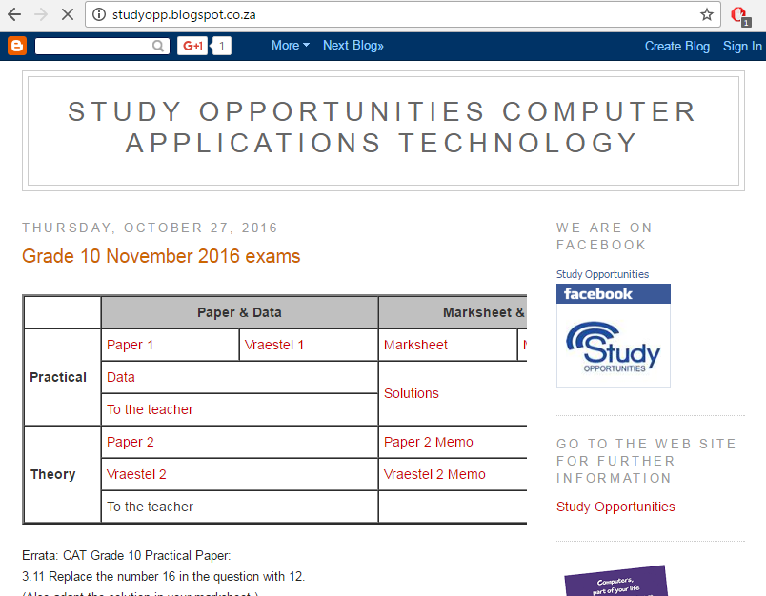
Introduction
Web pages and websites
Structure of a website
Hyperlink
Built-in connection to another website, webpage or other resource
indicated as text underlined in blue (or blue outline for a graphic)

Slide 6




Introduction
Web pages and websites
Structure of a website
Website must be hosted on web server (computer connected to the internet and that hosts websites)
Webmaster: person who maintains and develop website
Web pages are created in languages:
HTML
JavaScript
PHP
Python

Slide 7
Introduction
Web addresses
Format of a URL (Uniform Resource Locator)
 |  | Domain Name
www | . | Site name | . | Type of organization | . | Geographical location
www | . | studyopportunities | . | co | . | za
www | . | facebook | . | com
www | . | cia | . | gov
www | . | gamesdomain | . | co | . | uk
 |  | wiki.answers | . | com
 |  | en.wikipedia | . | org

Slide 8
Introduction
Web addresses
Examples of types of organisations:
com | any kind of organisation (used to be commercial organisations)
net | any kind of organisation (used to be organisations related to the internet)
biz | business
edu | education
gov | government
org | non-profit organisation
co | company
ac | academic organisation

Slide 9
Introduction
Web addresses
Examples of geographical abbreviations
for country domains:
za | South Africa
uk | United Kingdom
sa | Saudi Arabia
au | Australia
nz | New Zealand
us | United States
ls | Lesotho

Slide 10
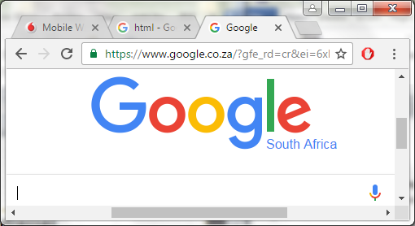
Introduction
Web addresses
IP Address: numerical address that uniquely identifies any computer/device connected to internet/network
Currently an IP address for www.google.co.za is 216.58.194.163
Access this site by typing either 216.58.194.163 or www.google.co.za in the address bar of a browser

Slide 11
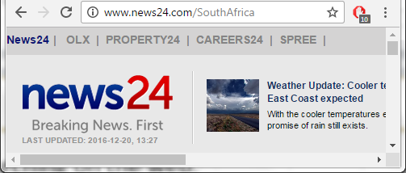
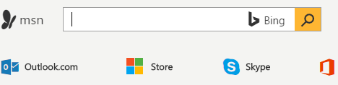

Types of websites
Web portal
Starting point for searching on web
Provides links to different subjects
Links to websites for news, weather, sport, etc.
Government web portals

Slide 12
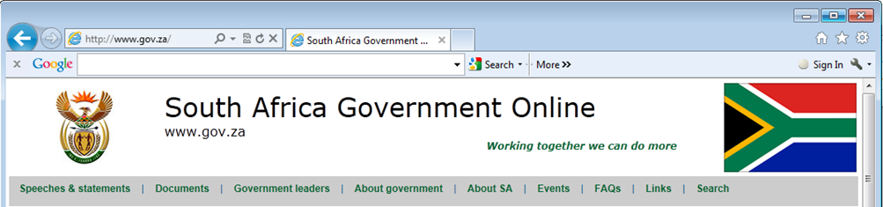
Types of websites
Informational website
Provides information to the public / customers / interested parties
School websites provide information to parents and learners
Most government institutions have an informational website – contains information relating to the department

Slide 13



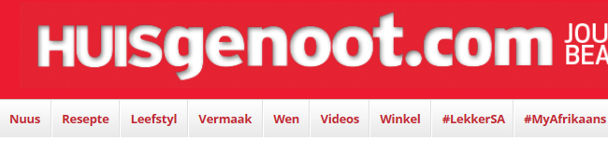
Types of websites
News website
Current events, sport, weather, exchange rates, etc.
Magazines and newspapers have website with summaries and extra material, such as video clips

Slide 14
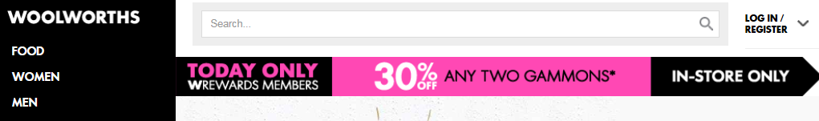


Types of websites
Business or marketing website
Contains information about products and services
Examples: Woolworths, Pick n Pay, Kulula, Telkom

Slide 15




Types of websites
Personal website
Anyone can create one – to share interests, hobbies and life experiences with the world
Most people use a blog or social networking site for their personal website

Slide 16

Types of websites
Wiki
A website that allows for collaborative creating and editing of web pages
Anyone can contribute – final article does not belong to any one individual
Access is usually free

Slide 17




Types of websites
Educational website
Offer ways of formal and informal learning by means of tutorials and simulations
Provide resource materials for educators

Slide 18
Types of websites
Entertainment website
Offers all forms of entertainment – online videos, music, sport, gaming and much more
Advocacy website
Describes an idea, opinion or cause
Usually presents the views of a particular group or association
Examples: SPCA and the Endangered Wildlife Trust (EWT)

Slide 19


Types of websites
Web application
Any application that is accessed only over the internet and is not stored on your local computer

Slide 20




Types of websites
Content aggregator
Website or application that gathers different web content (e.g. news, weather, movie reviews) from different online sources
Two main types:
1st type gathers info from various sources and displays it on its own website, e.g. IMDb, Rotten Tomatoes
2nd type gathers info from various sources and distributes it according to subscriber needs – e.g. Flipboard, Feedly

Slide 21

Activity 1

Slide 22
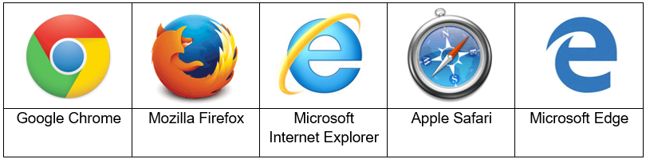
Browsing and searching
What is a web browser?
Software application that allows one to view and explore web pages on the Web, either via hyperlinks or by typing the address in the address bar of the web browser

Slide 23
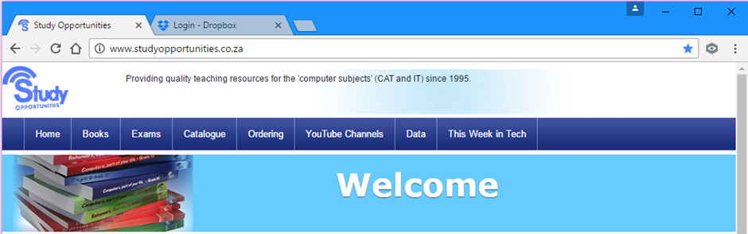
Browsing and searching
Features of web browsers
Address/Search bar
Home button
Back button
Tabbed browsing
Forward button
Bookmarks/Favourites
Refresh/Reload button
Customise/Tools

Slide 24

Browsing and searching
What is a search engine?
Program used to search for documents on the web by using keywords or phrases entered by the user

Slide 25
Browsing and searching
Successful searching
Step 1: Decide exactly what you want to find
Step 2: Identify keywords
Step 3: Use synonyms if necessary
Step 4: Use advanced search options
Do not forget to give credit where due: the BIBLIOGRAPHY is essential!

Slide 26
Activity 2
Spam
Cookies
Firewall
Internet of Things
Spyware
Phishing

Slide 27
Test and improve
Summary – concepts, terms and tips
Websites
WWW
Web page
Website
Home page of a website
Hyperlink
Web server
URL
IP address

Slide 28
Test and improve
Summary – concepts, terms and tips
Types of websites
Web portal
Informational
News
Business or marketing
Personal
Wiki
Educational
Entertainment
Advocacy
Web application
Content aggregator

Slide 29
Test and improve
Summary – concepts, terms and tips
Browsing and searching
Web browser
Search engine

Slide 30
Written module activity

